Slide 1

USGS Project Figures
Alexandre E. S. Georges
UC Berkeley – Civil and Environmental Engineering

Slide 2
Unstable Runs
The varying parameters are the following:
Pressure Gradient
0.25x: 0.00000025
0.5x : 0.0000005
1x : 0.000001
2x : 0.000002
4x : 0.000004
Alpha Coefficient
0.1
0.3
0.5
0.7
0.9

Slide 3
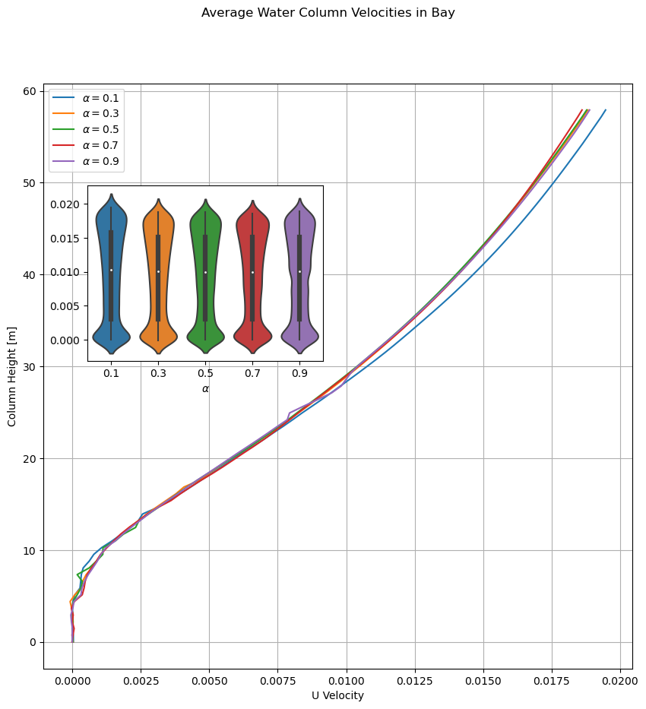
Unstable Runs – Bay x0.25

Slide 4
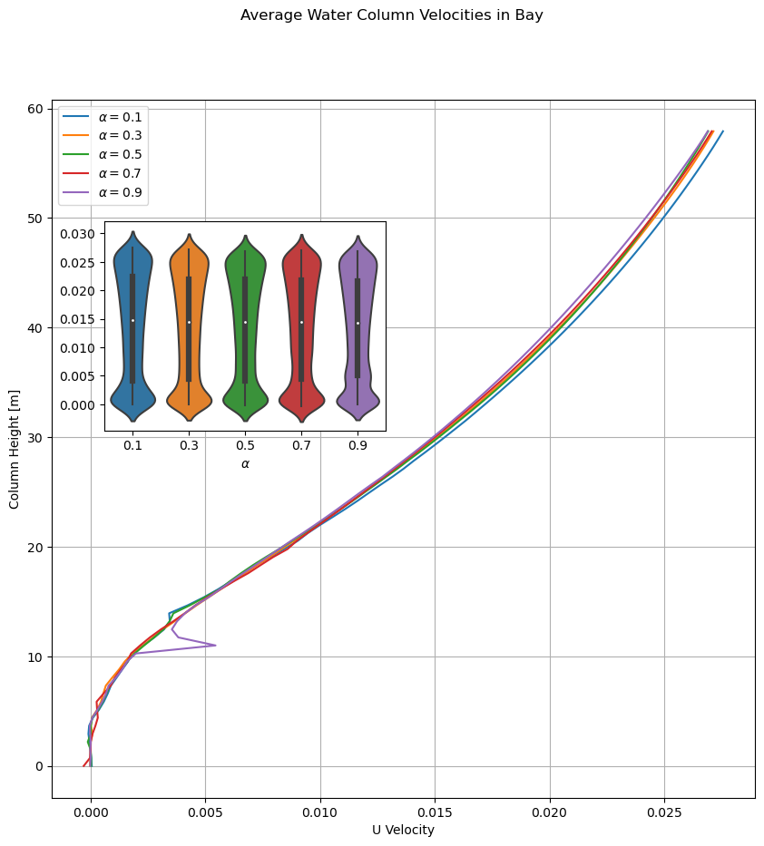
Unstable Runs – Bay x0.5

Slide 5
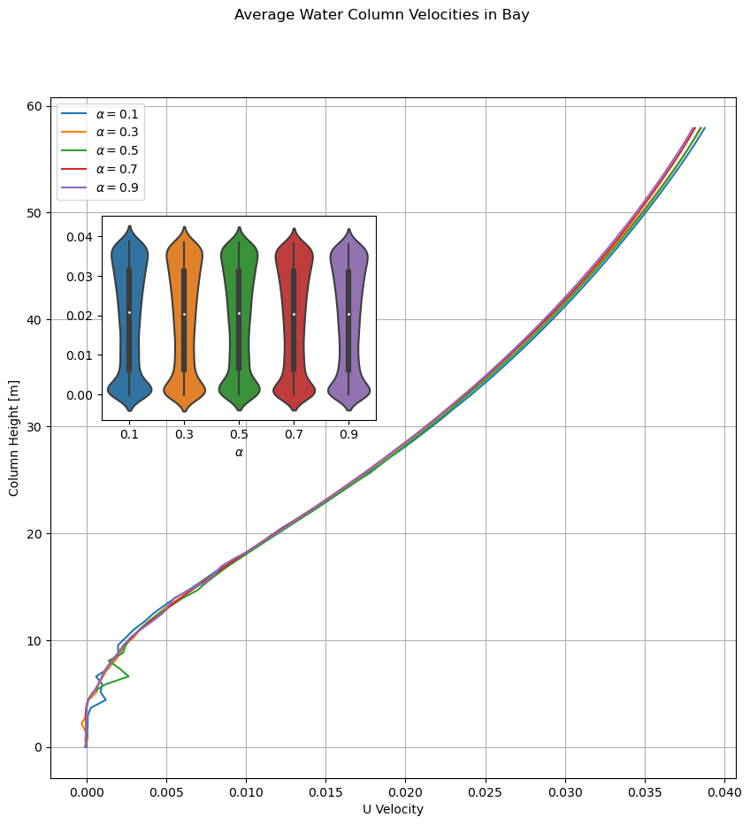
Unstable Runs – Bay x1

Slide 6
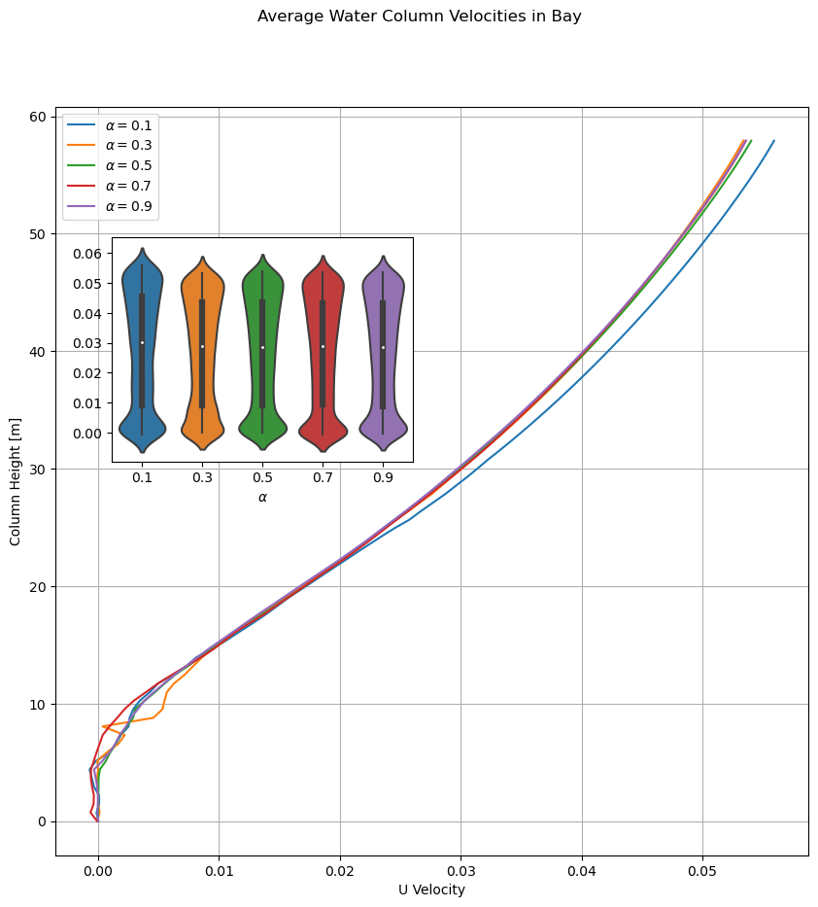
Unstable Runs – Bay x2

Slide 7

Unstable Runs – Bay x4

Slide 8
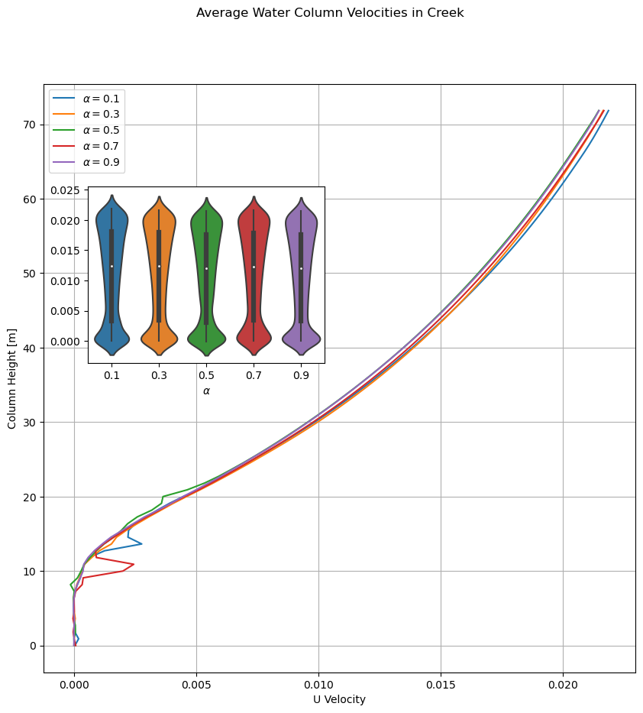
Unstable Runs – Creek x0.25

Slide 9
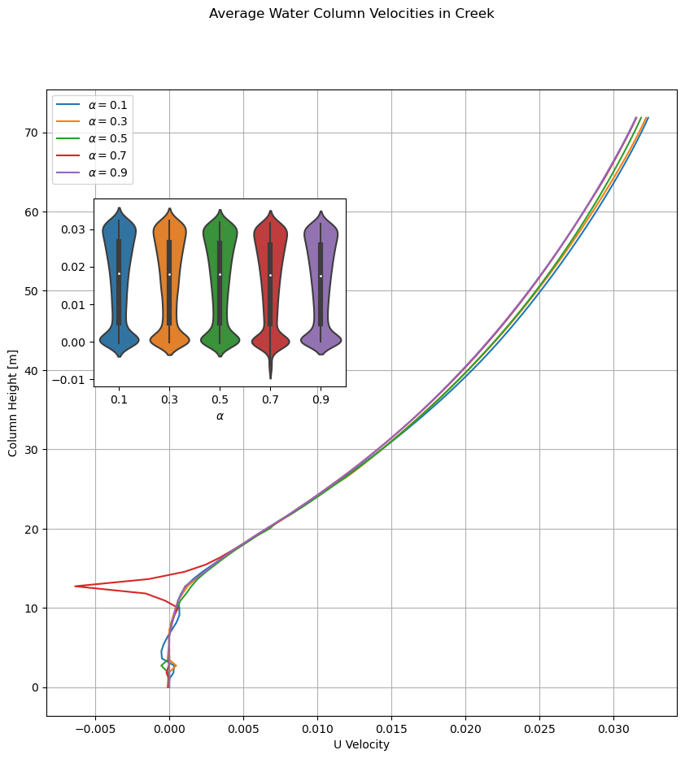
Unstable Runs – Creek x0.5

Slide 10
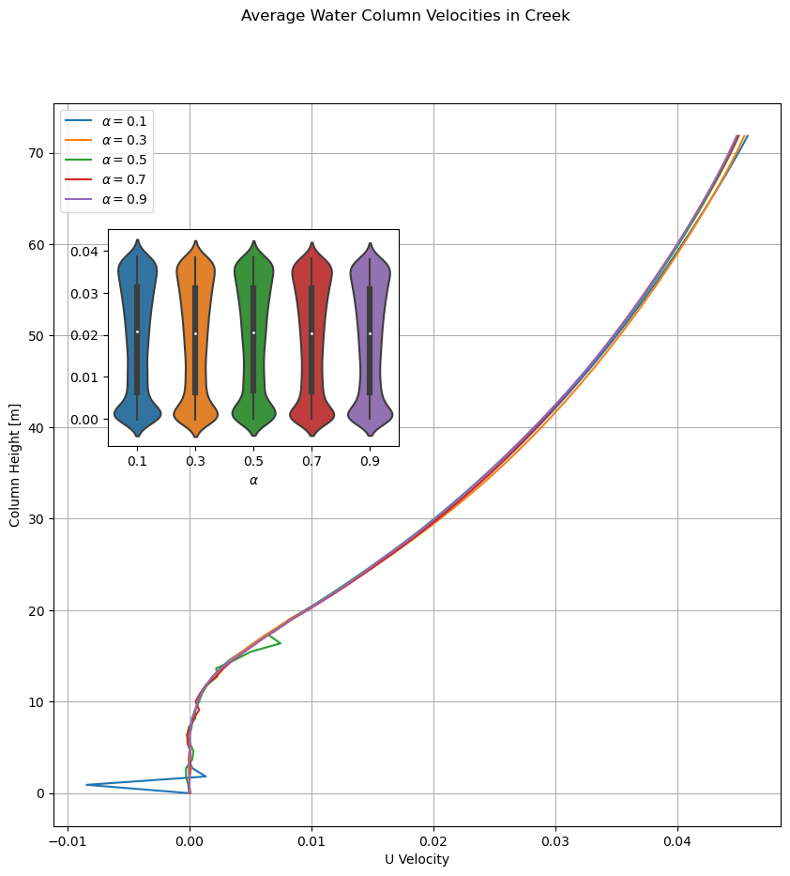
Unstable Runs – Creek x1

Slide 11
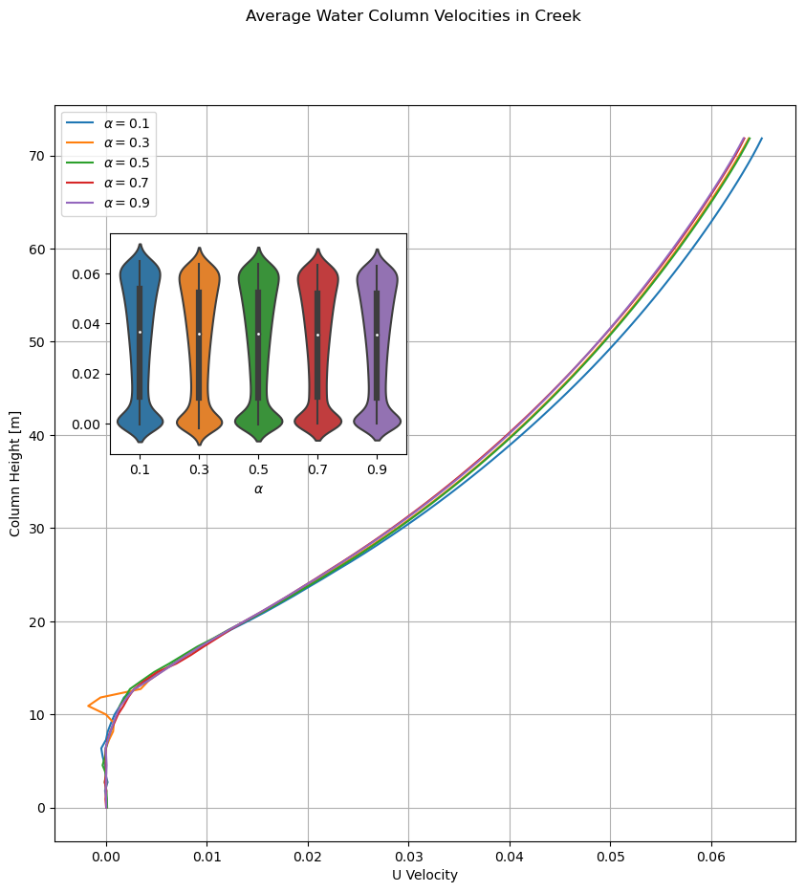
Unstable Runs – Creek x2

Slide 12

Unstable Runs – Creek x4

Slide 13
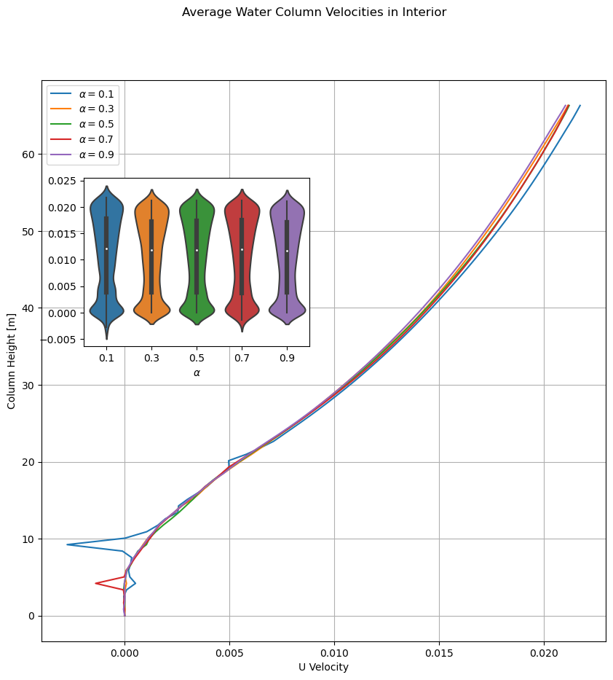
Unstable Runs – Interior x0.25

Slide 14
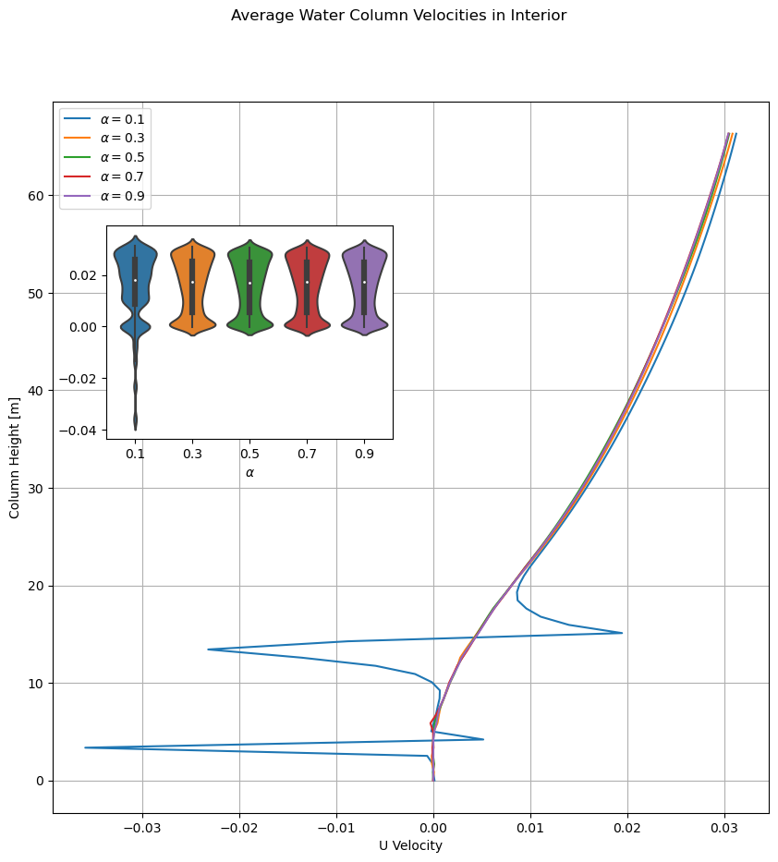
Unstable Runs – Interior x0.5

Slide 15
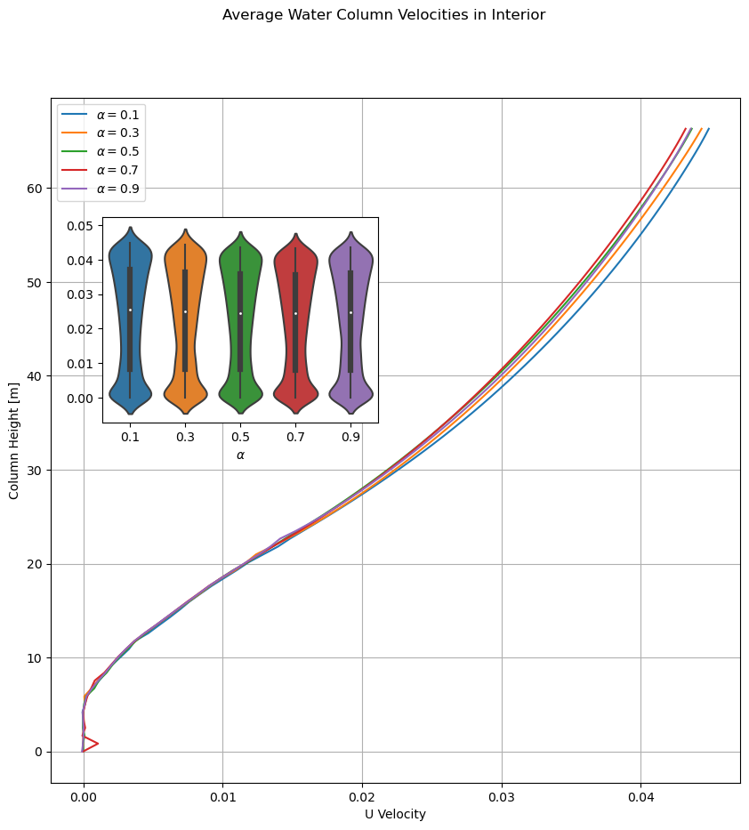
Unstable Runs – Interior x1

Slide 16
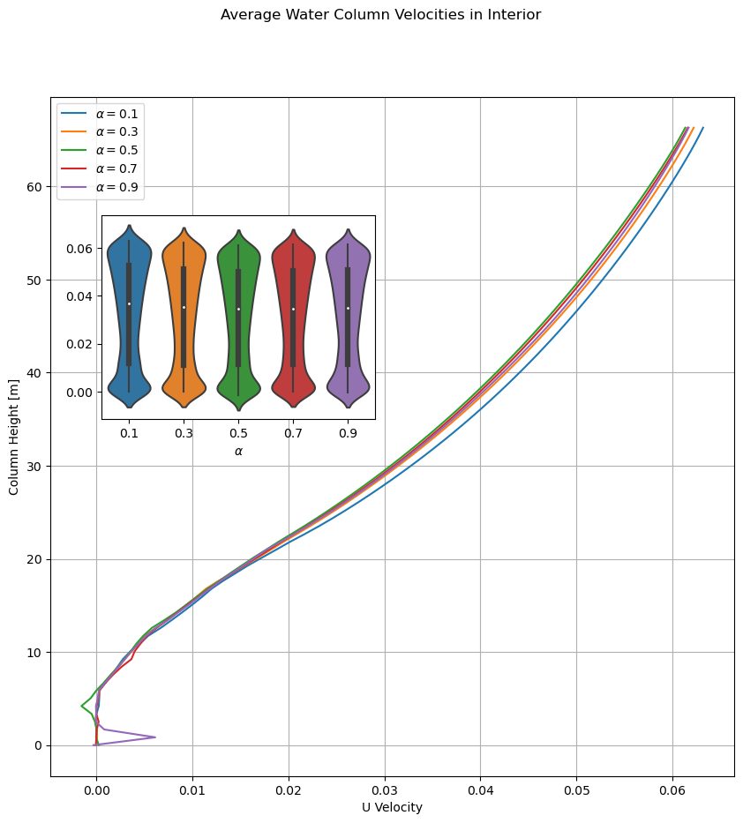
Unstable Runs – Interior x2

Slide 17

Unstable Runs – Interior x4

